Slide 1
Masked Implementation of PIPO Block Cipher on 8-bit AVR Microcontrollers
Hyunjun Kim, Minjoo Sim, Siwoo Eum, Kyungbae Jang, Gyeongju Song,
Hyunji Kim, Hyeokdong Kwon,Wai-Kong Lee, and Hwajeong Seo
(Hansung University)

Slide 2
Side-channel analytics attack
Side-channel analytics attack
An attack that obtains the secret key through unintended information generated when the cryptographic module operates
Power consumption, electromagnetic waves, etc.
Masking
By calculating a random value on sensitive information, the side channel information is not revealed.
Non-linear operations require additional operations compared to linear operations, which may increase speed and memory consumption.

Slide 3
PIPO
Designed for limited-resource IoT environments
A cipher that is characteristically focused on minimizing the number of non-linear operations.
A new lightweight S-box containing 11 non-linear bitwise operations is used
Efficient high-order masking possible

Slide 4
Motivation
PIPO is efficient for IoT environments with limited resources.
Lightweight encryption that can apply side-channel response techniques at low cost
Aims to maximize the effective masking advantage of PIPO

Slide 5
Contribution
1st masking using a minimized mask
Using two 8-bit masks
Proposal of masking scheme considering efficiency
Proposal of Masked OR Structure Considering Efficiency

Slide 6
Boolean masking
x’ = x ⊕ r , x = x’ ⊕ r
In PIPO, XOR operation, AND operation, and OR operation are used
Nonlinear operation Masking of AND operation and OR operation is required.

Slide 7
XOR Masking
When two mask values are the same in XOR operation
Different mask values must be used because the state of the mask is removed.
q0 = a ⊕ m0,
q1 = b ⊕ m1
q = q0 ⊕ q1 = ( a ⊕ m0) ⊕ (b ⊕ m1) = (a ⊕ b) ⊕ m2

Slide 8
AND Masking
ISW AND Masking Using 3 Masks
Mask state after operation is changed to new mask value
The two input values have different masking states.
q = a ∧ b = (a0 ⊕ a1) ∧ (b0 ⊕ b1)
= (a0 ∧ b0) ⊕ (a0 ∧ b1) ⊕ (a1 ∧ b0) ⊕ (a1 ∧ b1)
q0 = (m2 ⊕ (a0 ∧ b0) ⊕ (a0 ∧ b1) ⊕ (a1 ∧ b0) ⊕ (a1 ∧ b1) )
q1 = m2

Slide 9
OR Masking
ISW-OR can be calculated by replacing logical AND
a ∨ b = ( a ∧ b ) ⊕ a ⊕ b
q0 = (m2 ⊕ (a0 ∧ b0) ⊕ (a0 ∧ b1) ⊕ (a1 ∧ b0) ⊕ (a1 ∧ b1) ) ⊕ a0 ⊕ b0
q1 = m2

Slide 10
New OR Masking
Biryukov's And Masking
Constant value [m0 ∨ m1]
New OR Masking
q0 = (a0 ∧ b0 ⊕ (a0 ∧ b1 ⊕ b1)) ⊕ (a1 ∧ b0 ⊕ [m0 ∨ m1])
q1 = a1 = m1
q0 = (a0 ∧ b0 ⊕ (a0 ∨ b1)) ⊕ (a1 ∨ b0 ⊕ ([m0 ∨ m1] ⊕ b1))
q1 = a1 = m1

Slide 11
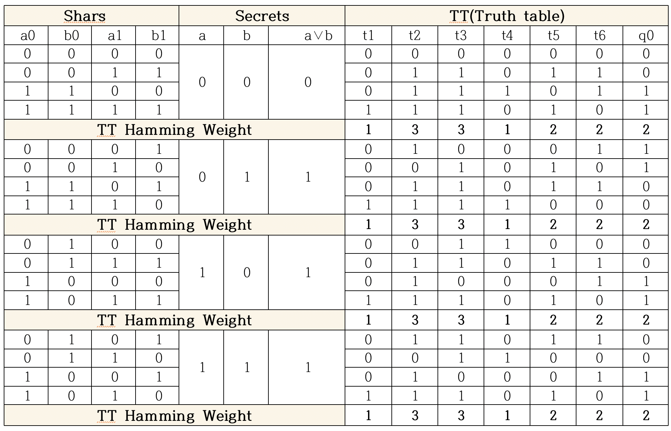
New OR Masking Truth table
t5
t6
q0 = (a0 ∧ b0 ⊕ (a0 ∨ b1)) ⊕ (a1 ∨ b0 ⊕ ([(m0 ∨ m1)] ⊕ b1))
q1 = a1 = m1
t1
t2
t3
t4

Slide 12
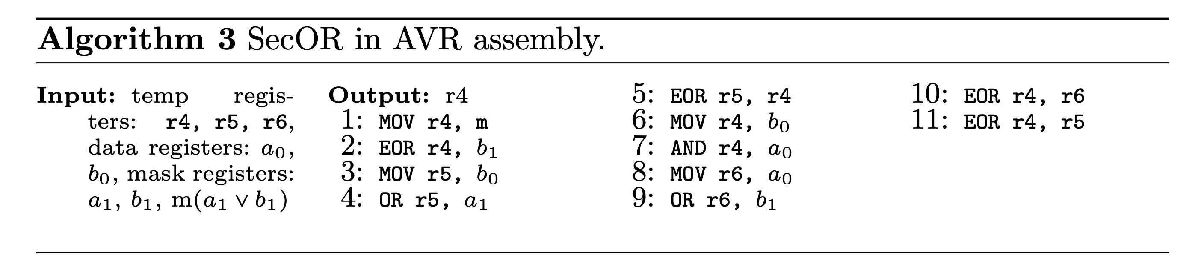
New OR Masking
q0 = (m2 ⊕ (a0∧b0) ⊕ (a0∧b1) ⊕ (a1∧b0) ⊕ (a1∧b1) ) ⊕ a0 ⊕ b0
q1 = m2
q0 = (a0 ∧ b0 ⊕ (a0 ∨ b1)) ⊕ (a1 ∨ b0 ⊕ ([m0 ∨ m1] ⊕ b1))
q1 = a1 = m1
 | AND | OR | XOR | Mask
[1] | 4 | 0 | 6 | 3
Our | 1 | 2 | 4 | 2

Slide 13
Using two 8-bit masks
Using two 8-bit random masks m0, m1 and m2 = m0 ⊕ m1
Easily manage mask status
Two mask values indicate the rest of the mask.
When calculating the same mask state
It is necessary to change the mask state
q = (a0 ⊕ m0) ⊕ (b0 ⊕ m0)
→ q = ((a0 ⊕ m0) ⊕ m2) ⊕ (b0 ⊕ m0) = (a0 ⊕ m1) ⊕ (b0 ⊕ m0)

Slide 14
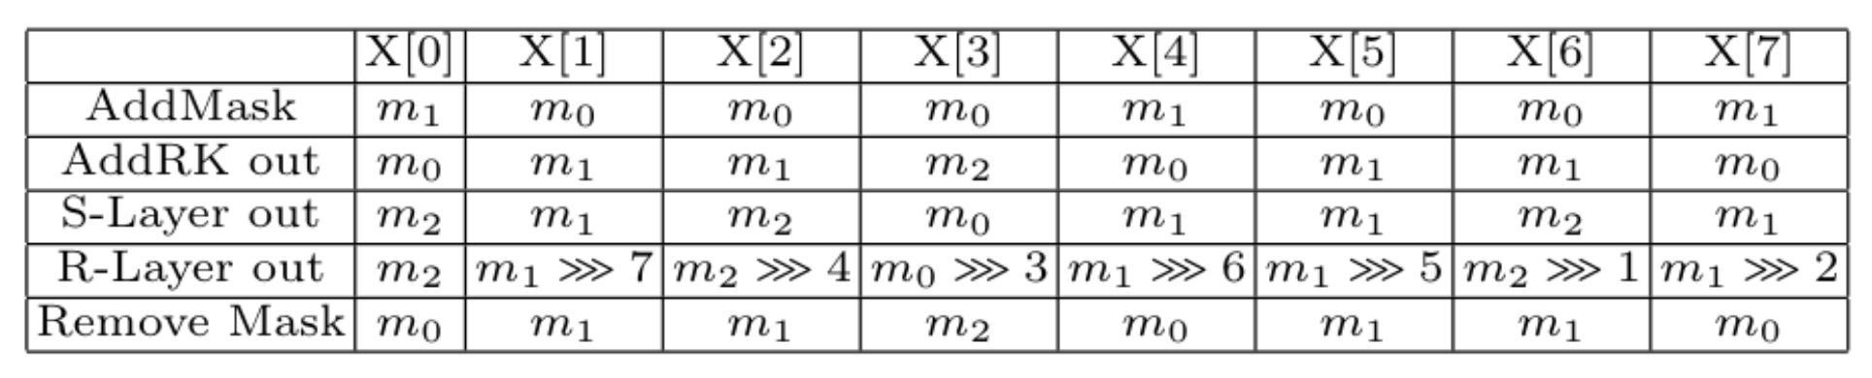
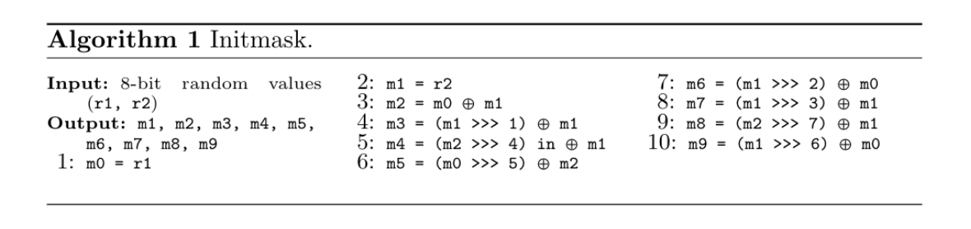
Same mask state output
Makes the mask state of the function output fixed
No new mask required after initial mask creation

Slide 15
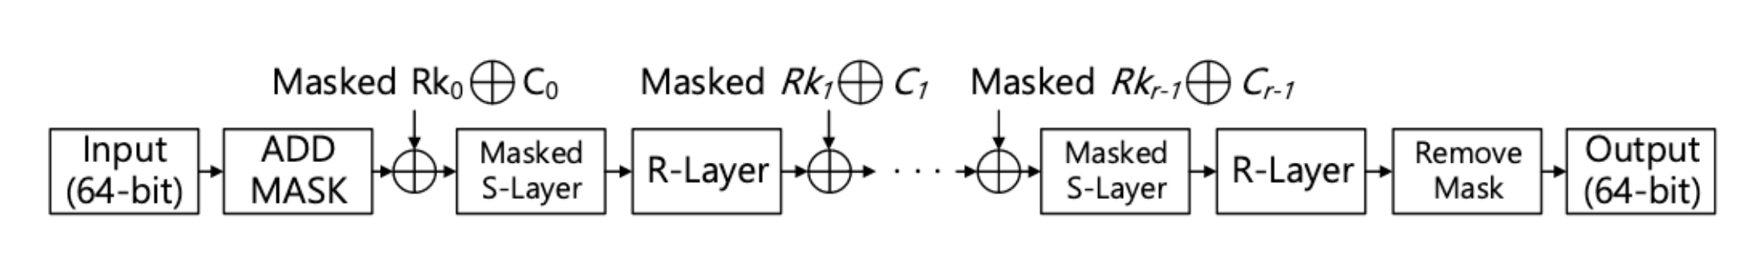
Masking Scheme
S-layer : 23 additional AND operations, 5 OR operations, and 46 additional XOR operations
AddRK & P-layer : There is no additional operation due to pre-computation

Slide 16
Power analysis of the proposed masked PIPO
PIPO-64/128 targets implemented with bit-slicing
Use ChipWhisper-Lite for 8bit processor ATxmega128 MCU
Collect 10,000 waveforms from Round 1 to Round 3.

Slide 17
Evaluation
ATmelStudio simulator was used and optimization level O2
Comparing clock cycles to reference code
Method | C | ASM(cycles)
 | 2,321 | 1,576
Our | 6.169 | 3,462
Overhead factor | 2.7 | 2.2

Slide 18
Conclusions and Future Work
Conclusion
We propose an efficient first-order masking technique for the lightweight crypto PIPO.
For masking, a 2-byte random mask is used to minimize the cost of generating a mask, and for this, a new OR operation masking is proposed.
Future Work
Applying efficient high-order masking to PIPO in various environments in the future

